Slide 1

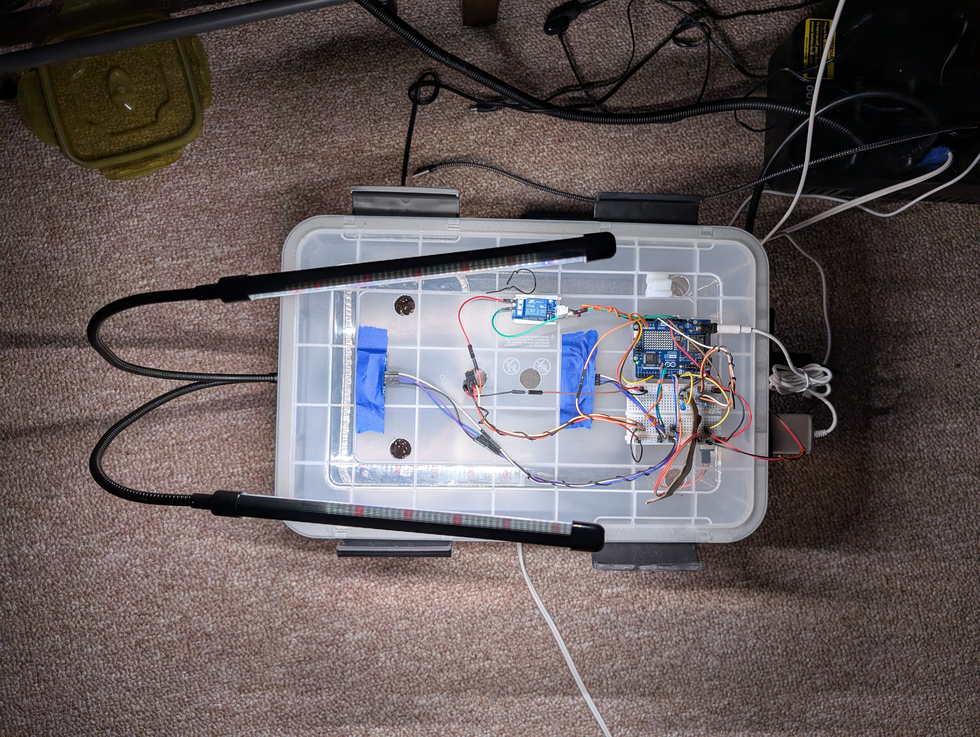
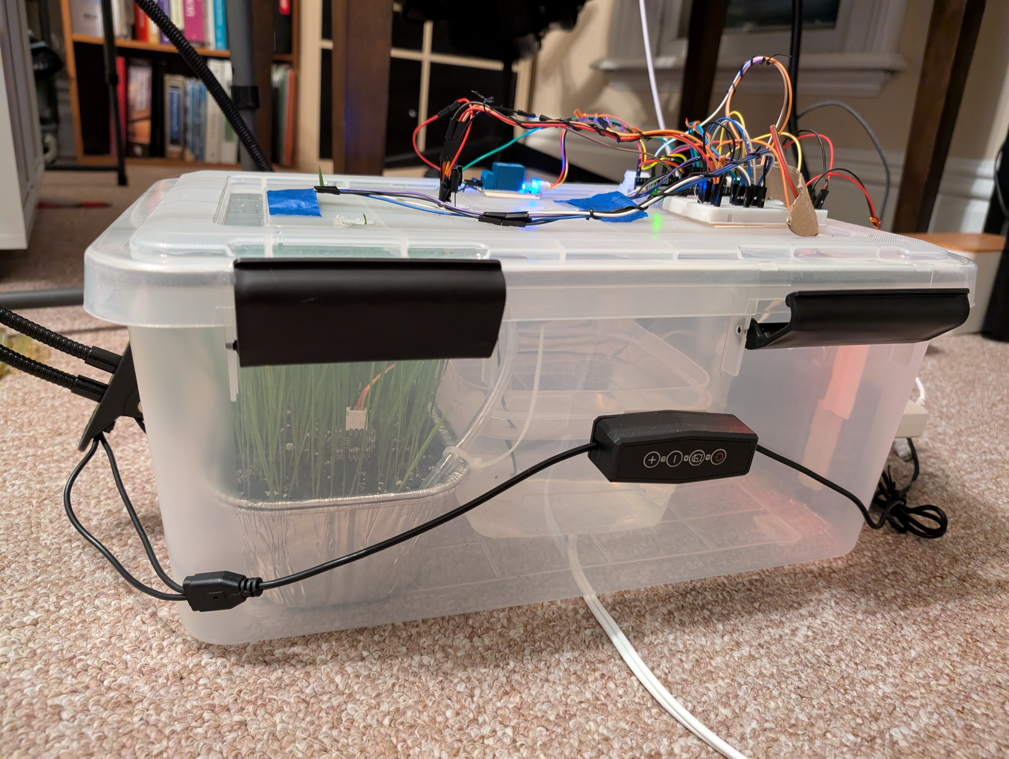
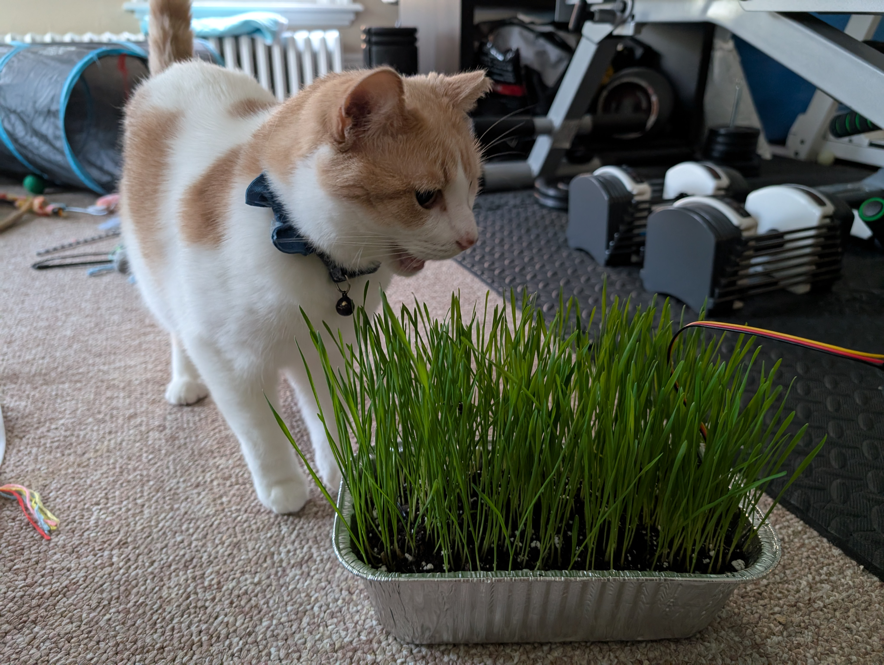
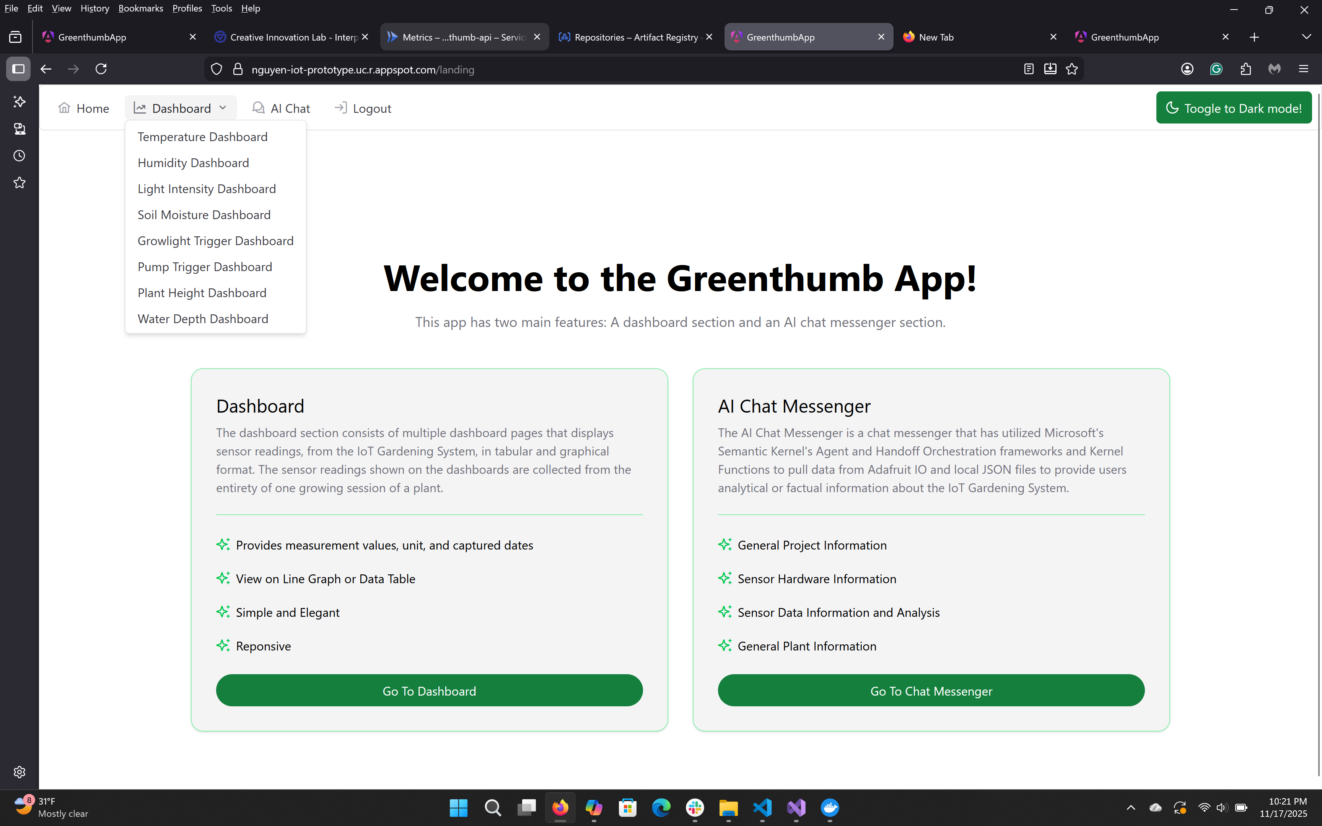
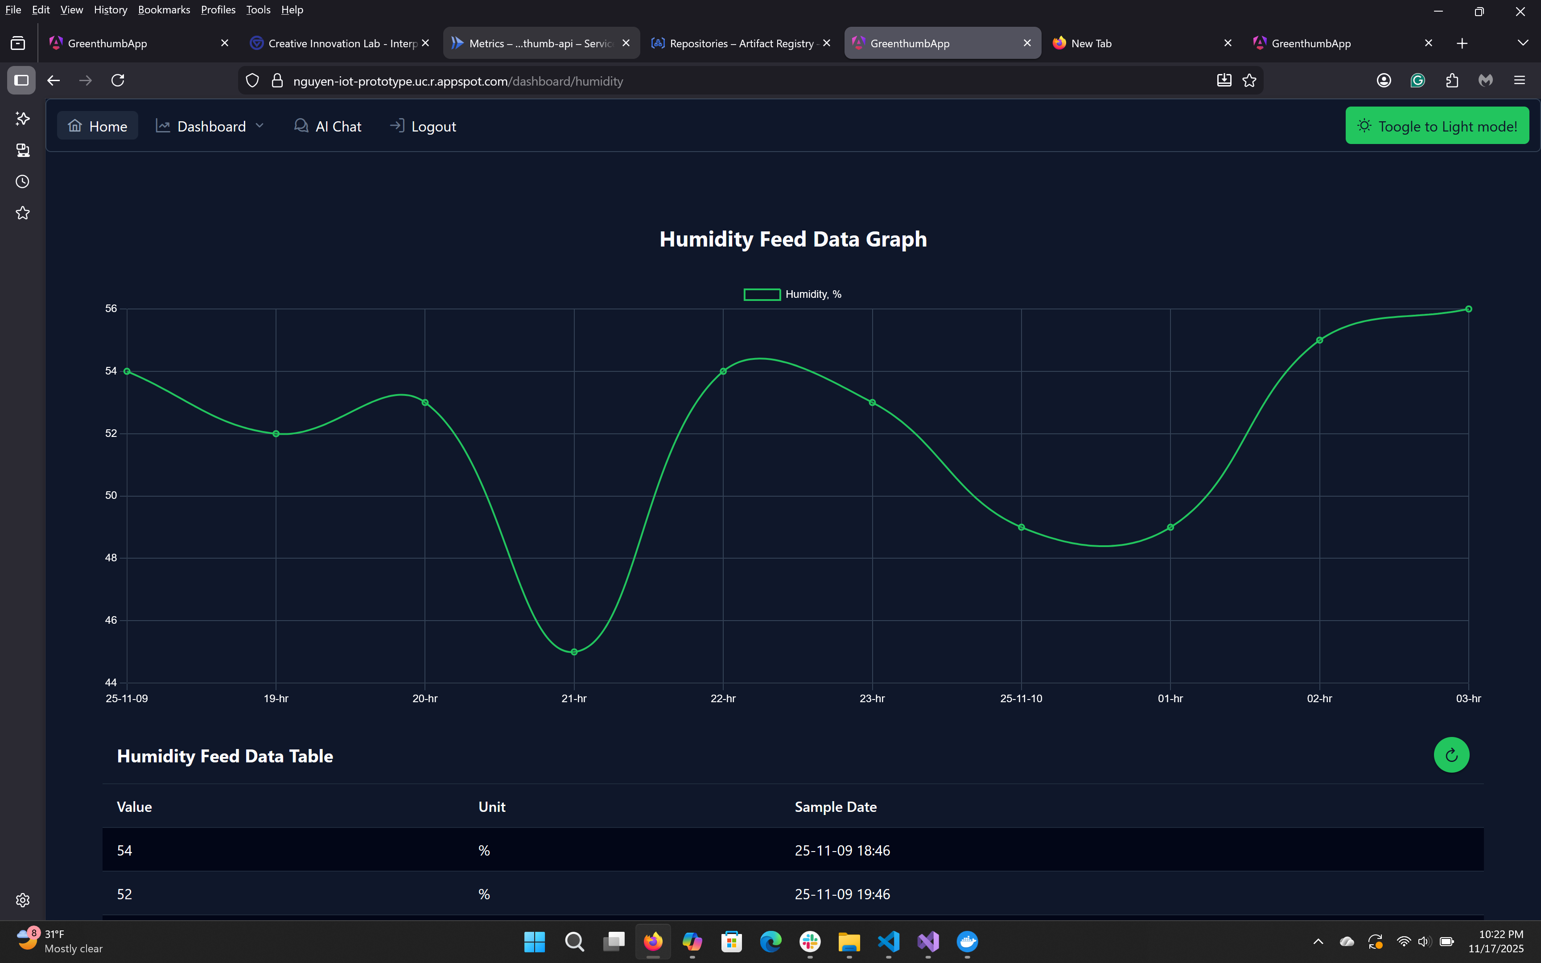
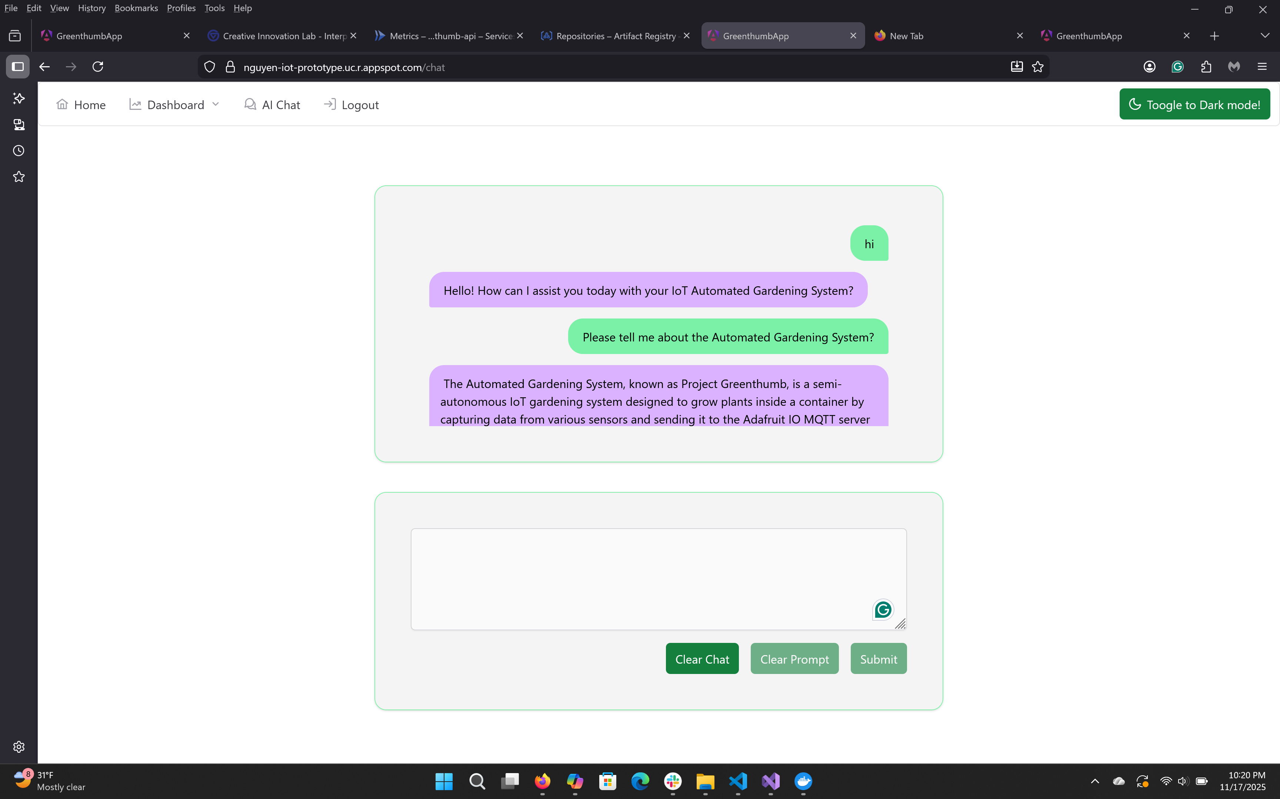
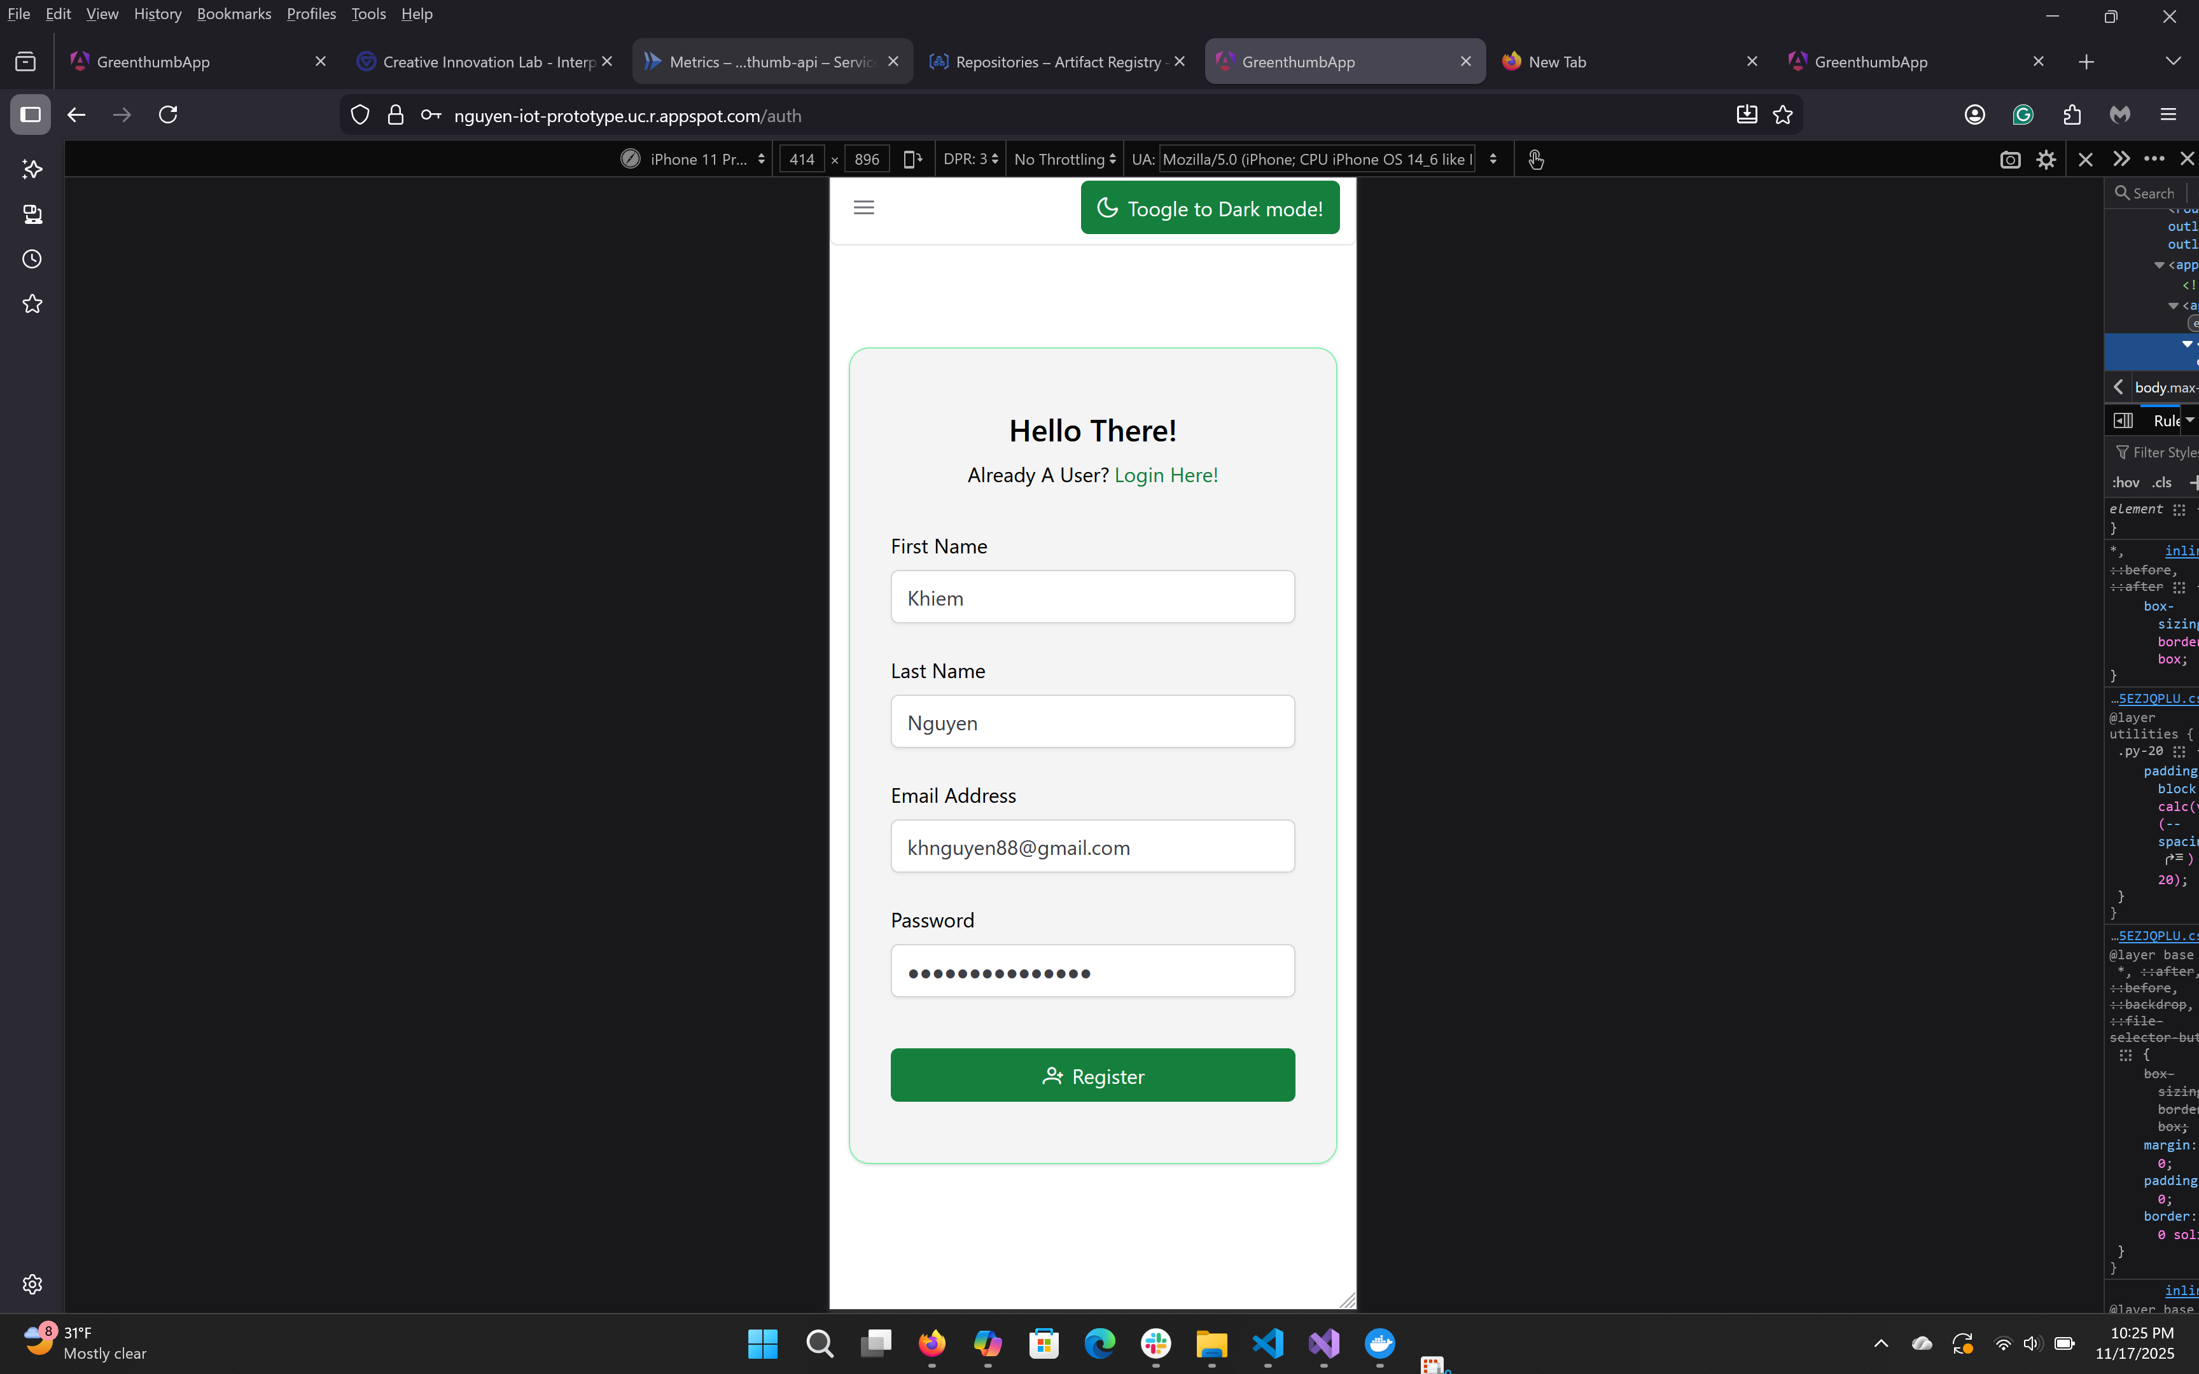
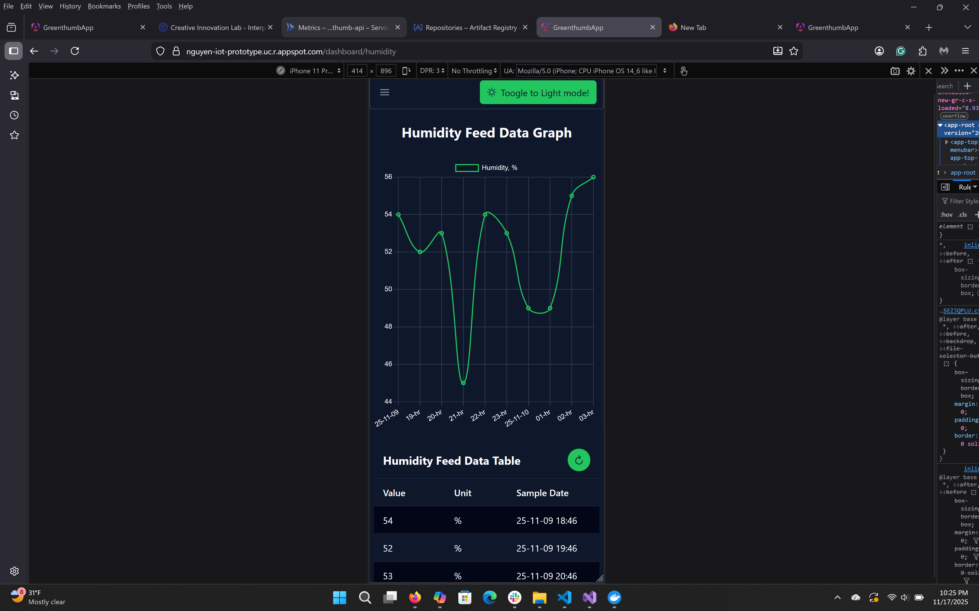
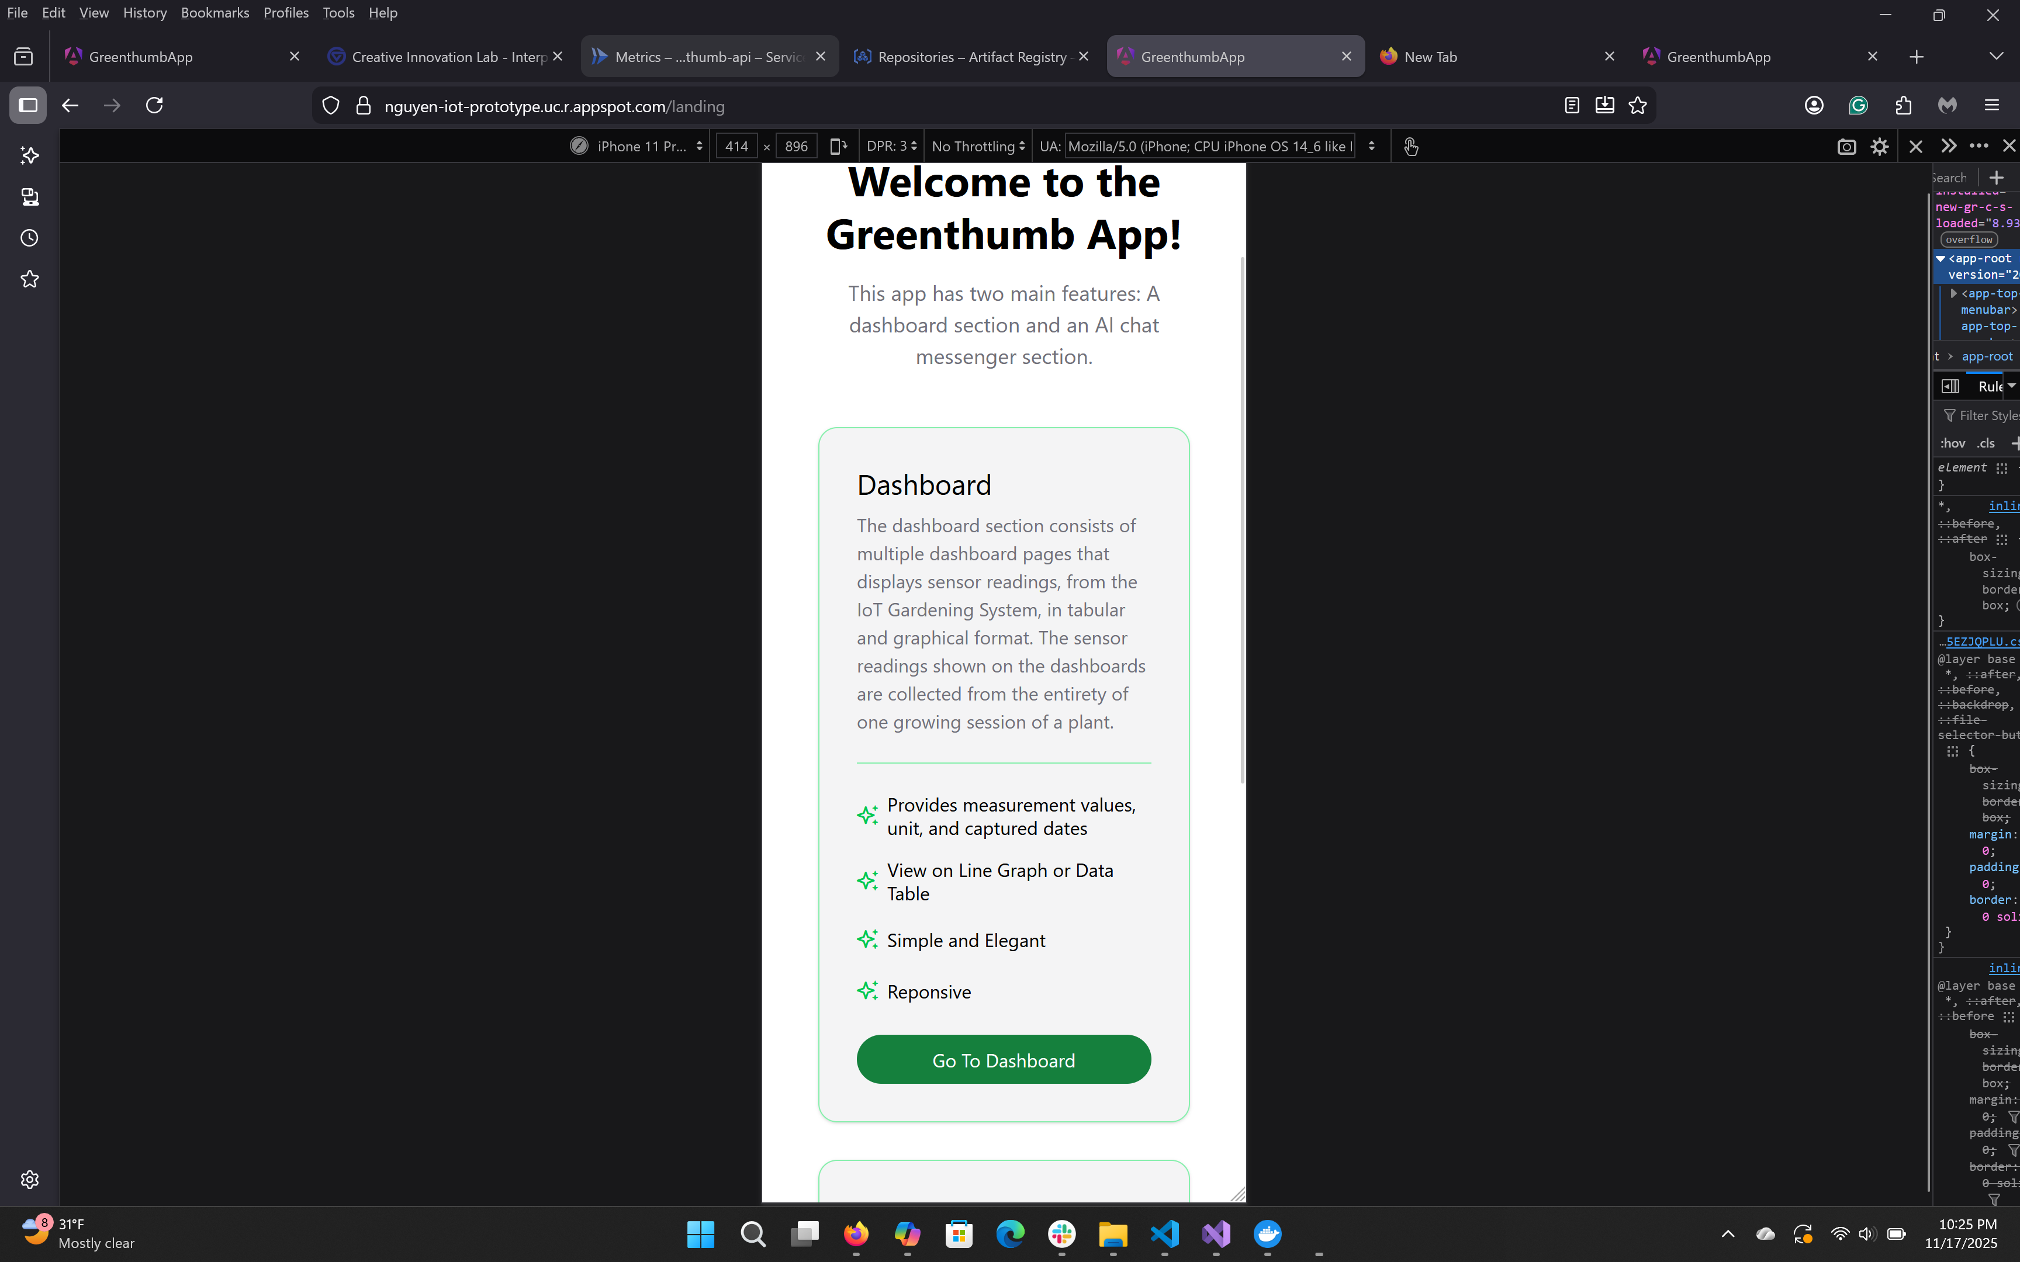
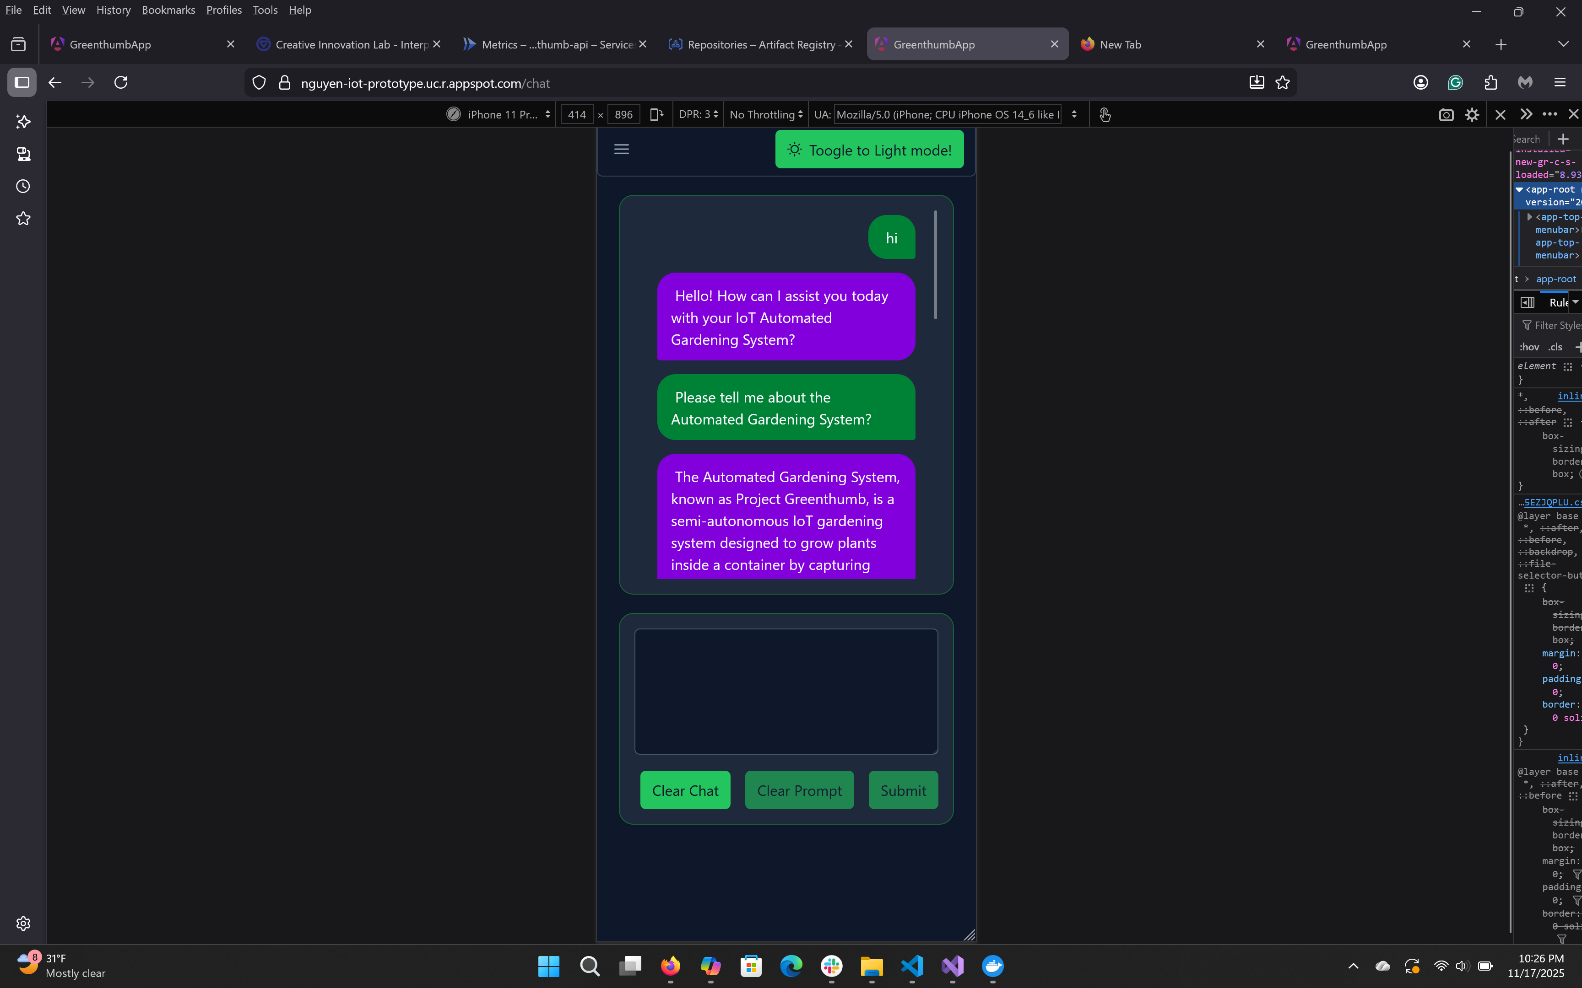
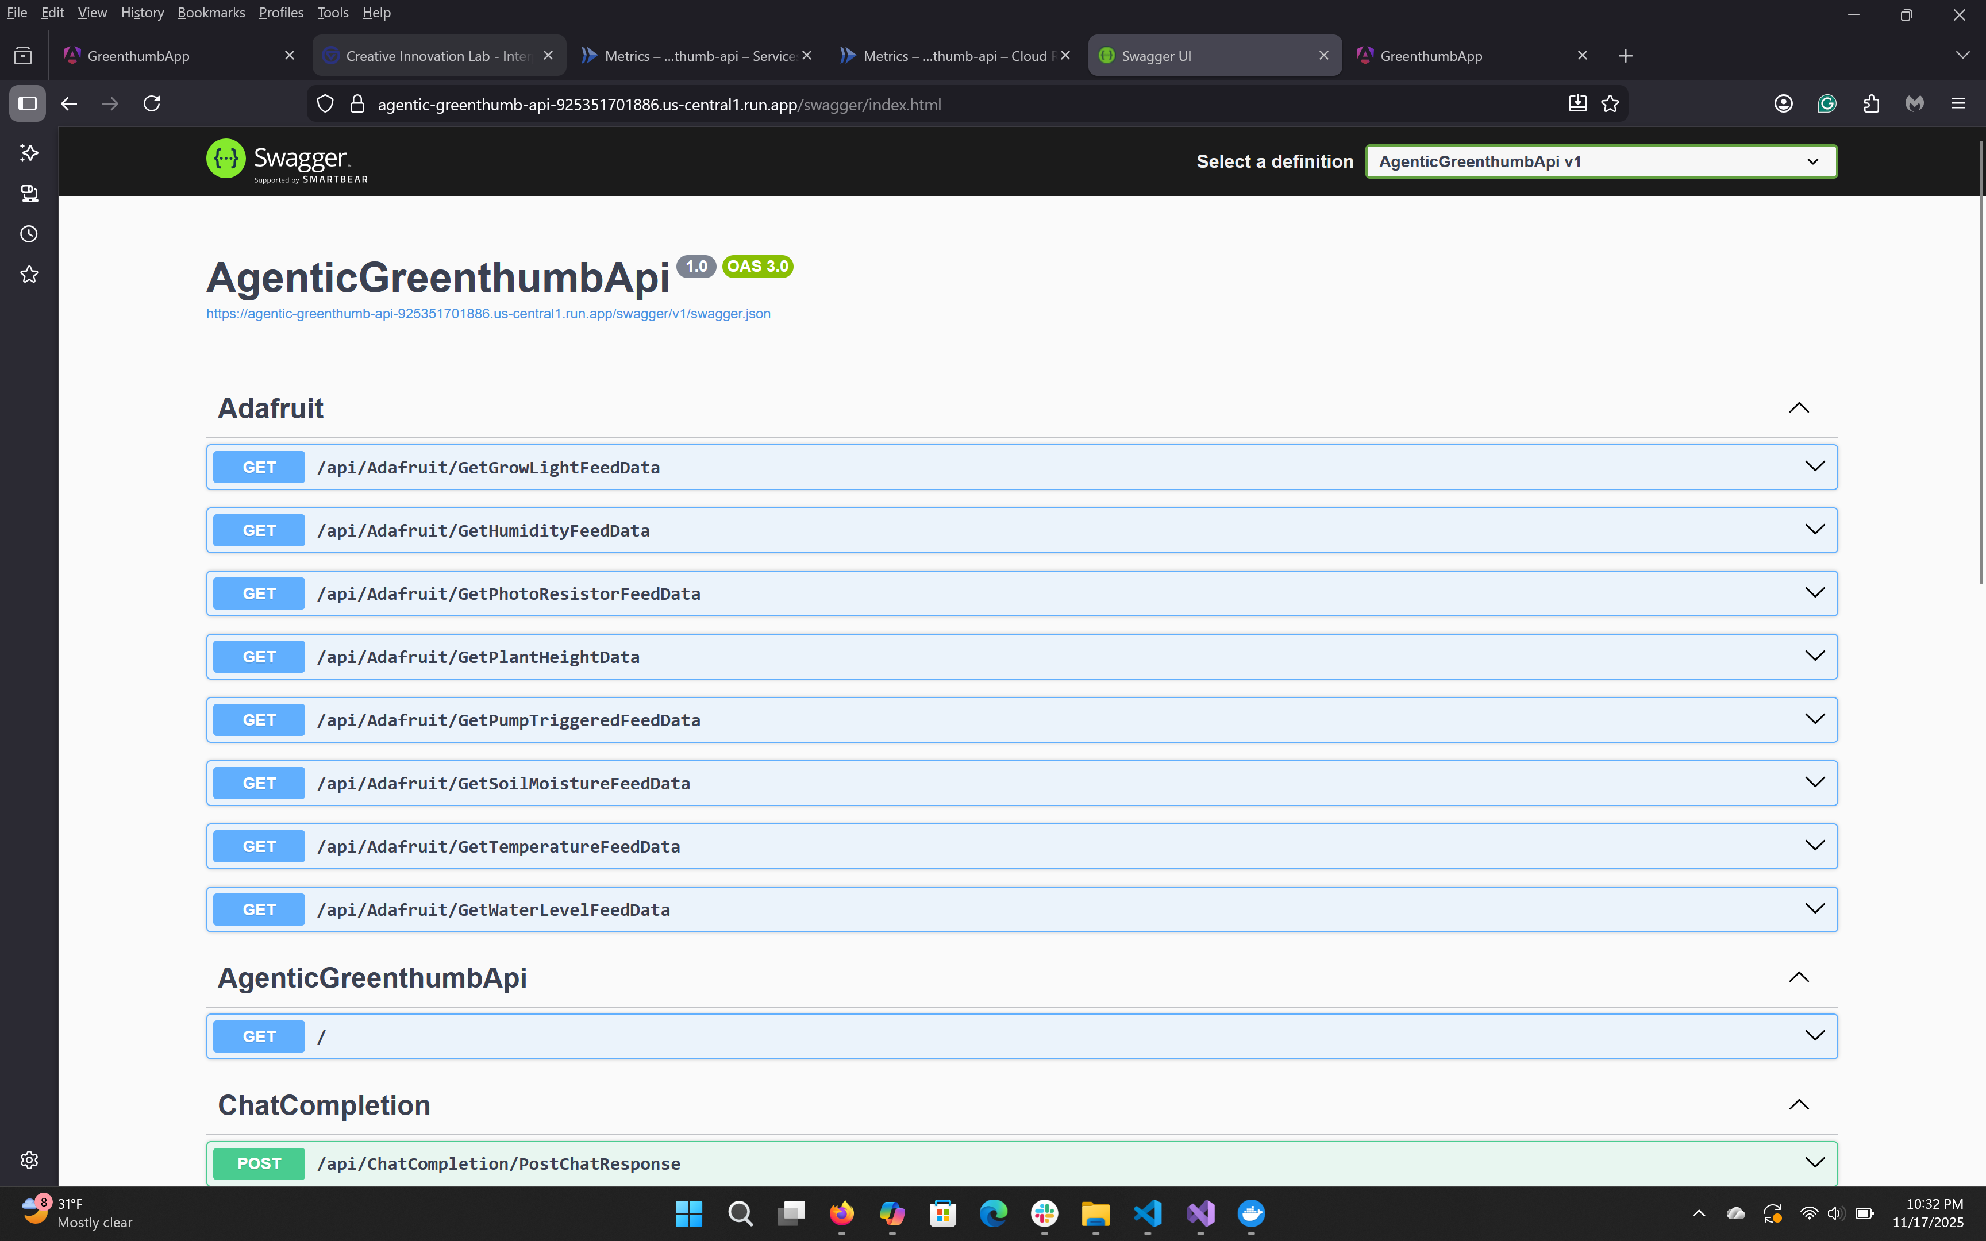
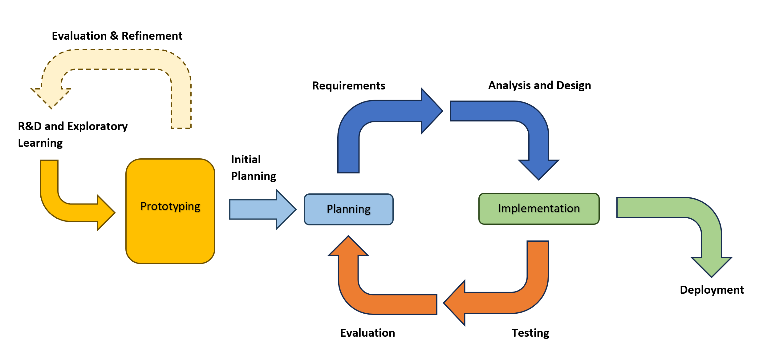
PROJECT GREENTHUMB:
SEMI-AUTONOMOUS IOT GARDENING SYSTEM
Khiem Hoang Nguyen
Advisor: Erik Fredericks
Results/Implementation
Introduction
`
Technical Features
The semi-automated IoT Gardening System was
The project
The
Proposed Future Improvements
Embedded Hardware:
Upgrade the ultrasonic sonar sensors with water meter sensor, LiDAR sensor, and camera to improve accuracy measuring plant growth and water supply levels.
Embedded Application:
Refine existing code, continue support for the ultrasonic sensor, and implement code for new sensors and camera
Adjust concurrent timers and frequency of sensor reading and data publication to Adafruit IO (MQTT Broker)
Enable MQTT subscription features to allow users to adjust parameters while the Gardening System is running
Frontend Application:
Add Embedded System Settings page for embedded application parameters customization
Add a Users Settings page for web application customization
Backend Application:
Revise and make the Chat Completion Service extensible by giving users ability to generate and configure agents and orchestration through YAML template and config files; including LLM model selection
Create an extensible Data Service and interface to support different database services and connection, including local database, that can be selected via a configuration file.
Implement new service to accept and process images from camera
Developmental Lifecycle
Major Challenges and Solutions
Embedded Hardware:
Had to limited knowledge in circuitry, but learned and applied basic circuitry in a short timeframe
Encountered sensors that provided faulty readings, debugged and developed a checklist of each root caused encountered to streamline debugging process
Embedded Application:
Had to limited knowledge in C++, but learned and program in the language in a short timeframe
VS Code IDE could not find Arduino Library, and developed workaround by coding in VS Code IDE and compiling and debugging code in Arduino IDE.
Frontend Application:
Angular UI Component Library, PrimeNG, updated it’s theming system and styles customization process, and had poor documentations, but learned new theming system through online resources.
Backend Application:
Had to limited knowledge in agentic design and orchestration, but learned and applied them into application through reading Microsoft Semantic Kernel documentaiton and building prototypes.
Cloud Run deployment of the backend application onto the cloud required additional process of generating a Docker image of the application and uploading it onto GCP’s Artifacts Registry
The project followed a hybrid software developmental process, which combined the Exploratory and Iterative Developmental models. The initial part of the process relied heavily on prototyping and the development of thruway application to build the knowledge on concepts and topics that were never covered in the graduate program’s academic curriculum or used at work, such as embedded design and circuitry, IoT, and agentic design. The exploratory process helped refine the project’s scope and feasibility based on the knowledge gained and contributed to the initial plans for the project.

